Slide 1
SolarPV System

Slide 2
Overview
Objectives
Assumptions
Application Overview
Demonstration
Discussion
Contents

Slide 3
Industry Accepted Modelling
Proven Mathematical Models
Test based Performance Parameters
Comprehensive Analysis
24 hours/day 365 day year
Location dependent Atmospherics
Open Sourced
No Licensing Fees
Source Code Available for Modification
Overview

Slide 4
Promote Good Engineering Practices
Orderly Approach to System Design
Comprehensive Definition of Design Elements
Enable Rapid Evaluation of Alternatives
Easily change parameters
Rapid Modelling and Results
Deliver achievable solution
Delivers what is promised
Provides for cost benefit tradeoffs
Objectives

Slide 5
Solar Panel Array
Charge Control
Inverter
Load
Performance Variables:
* Panel Specs
* Tilt & Azimuth
* Lat, Lon, Elev
* Temp & Wind
Installation Variables:
* Grid Voltage
* Grid Frequency
* User Power Usage
Battery
Bank
Performance Variables:
* Days of Autonomy
* Depth of Discharge
* Bat Specs
Assumptions

Slide 6
Python 3.x Libraries
Systematic Design
Graphical User Interface Driven
Results Display & Reporting
Application Overview

Slide 7
Key Python Libraries
tKinter – Application GUI
Pvlib – Irradiance & Performance Predictions
Pandas – excel-like data structures
Numpy – data Array structures
Matplotlib – graphical plots
Python 3.x Libraries

Slide 8
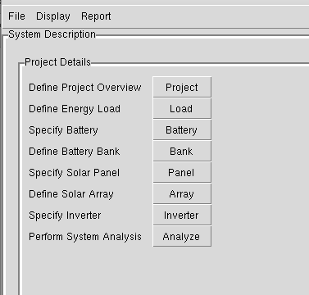
Promotes Organized Design
Location
Load
Battery
Battery Bank
Panel Module
Array
Inverter
Systematic Design

Slide 9
GUI Driven

Slide 10
Results

Slide 11
Demonstration

Slide 12
What did you like?
What didn’t you like?
What is it missing?
Discussion

